Slide 1
Welcome to Hack Camp!

Slide 2
So you thought you signed up for a programming camp…

Slide 3
Oops.

Slide 4
Why are we doing this?

Slide 5
To show that there’s the possibility of creating what you see missing in the world and not being afraid to break the rules.

Slide 6
There are 3 parts to this: - designing who you are - executing on the design - not being afraid

Slide 7
Who’s Played With LEGO’s?

Slide 8
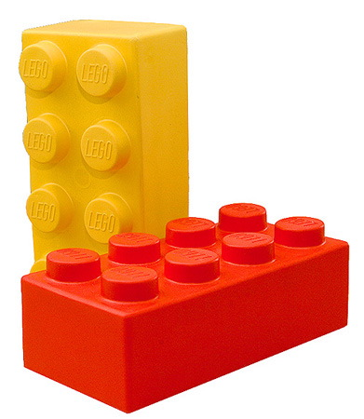

Slide 9
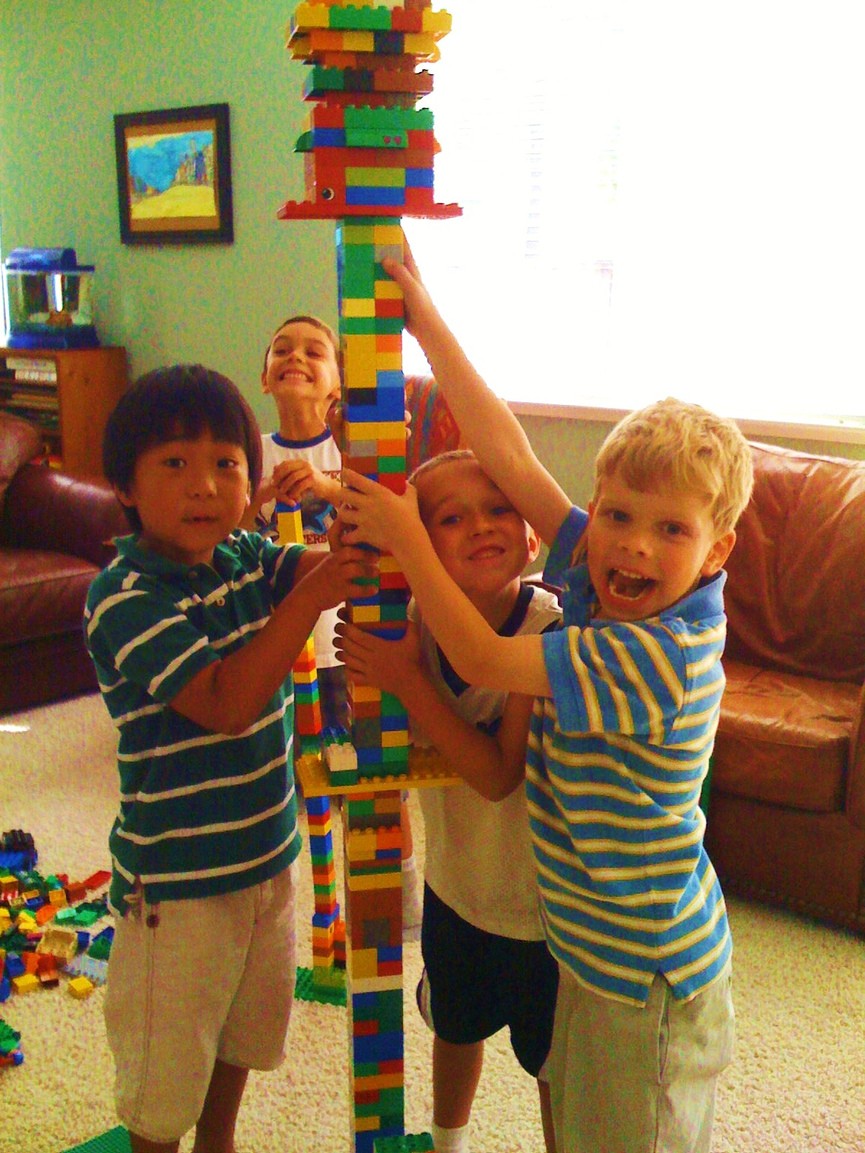
Had the power to build anything!

Slide 10
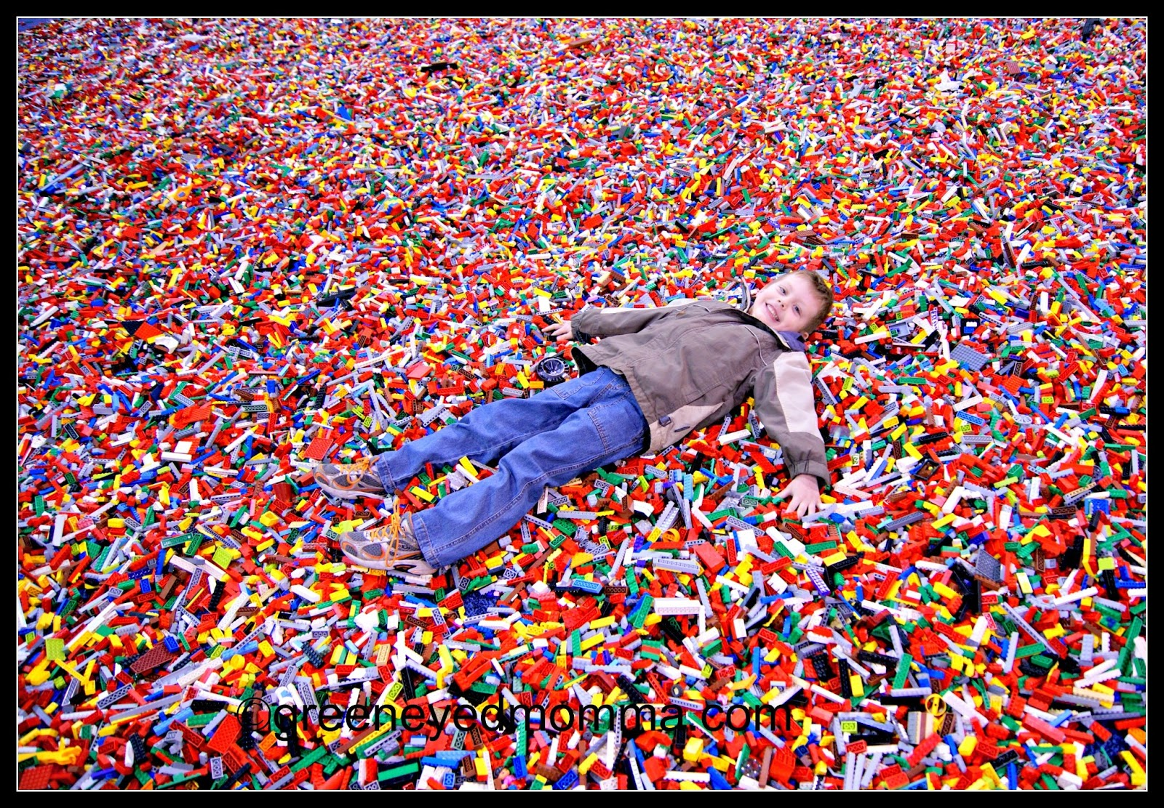
I wanted to be this kid

Slide 11
Had the power to build anything!

Slide 12
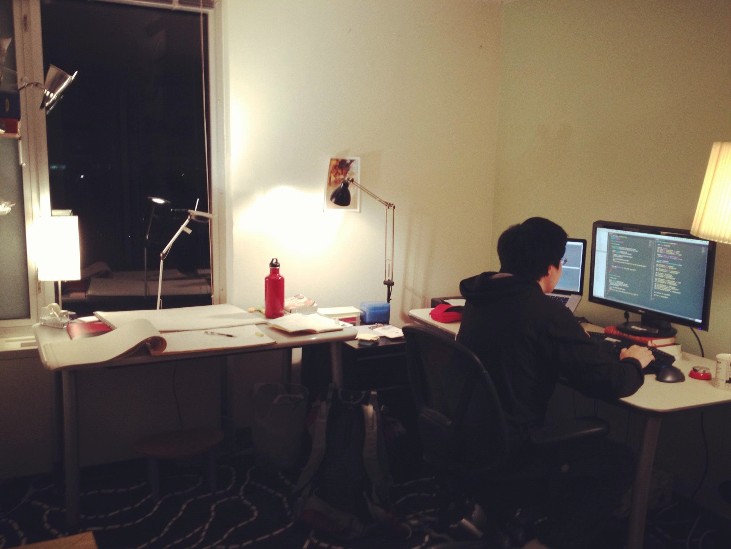
That’s What Coding Really Is

Slide 14


Slide 15
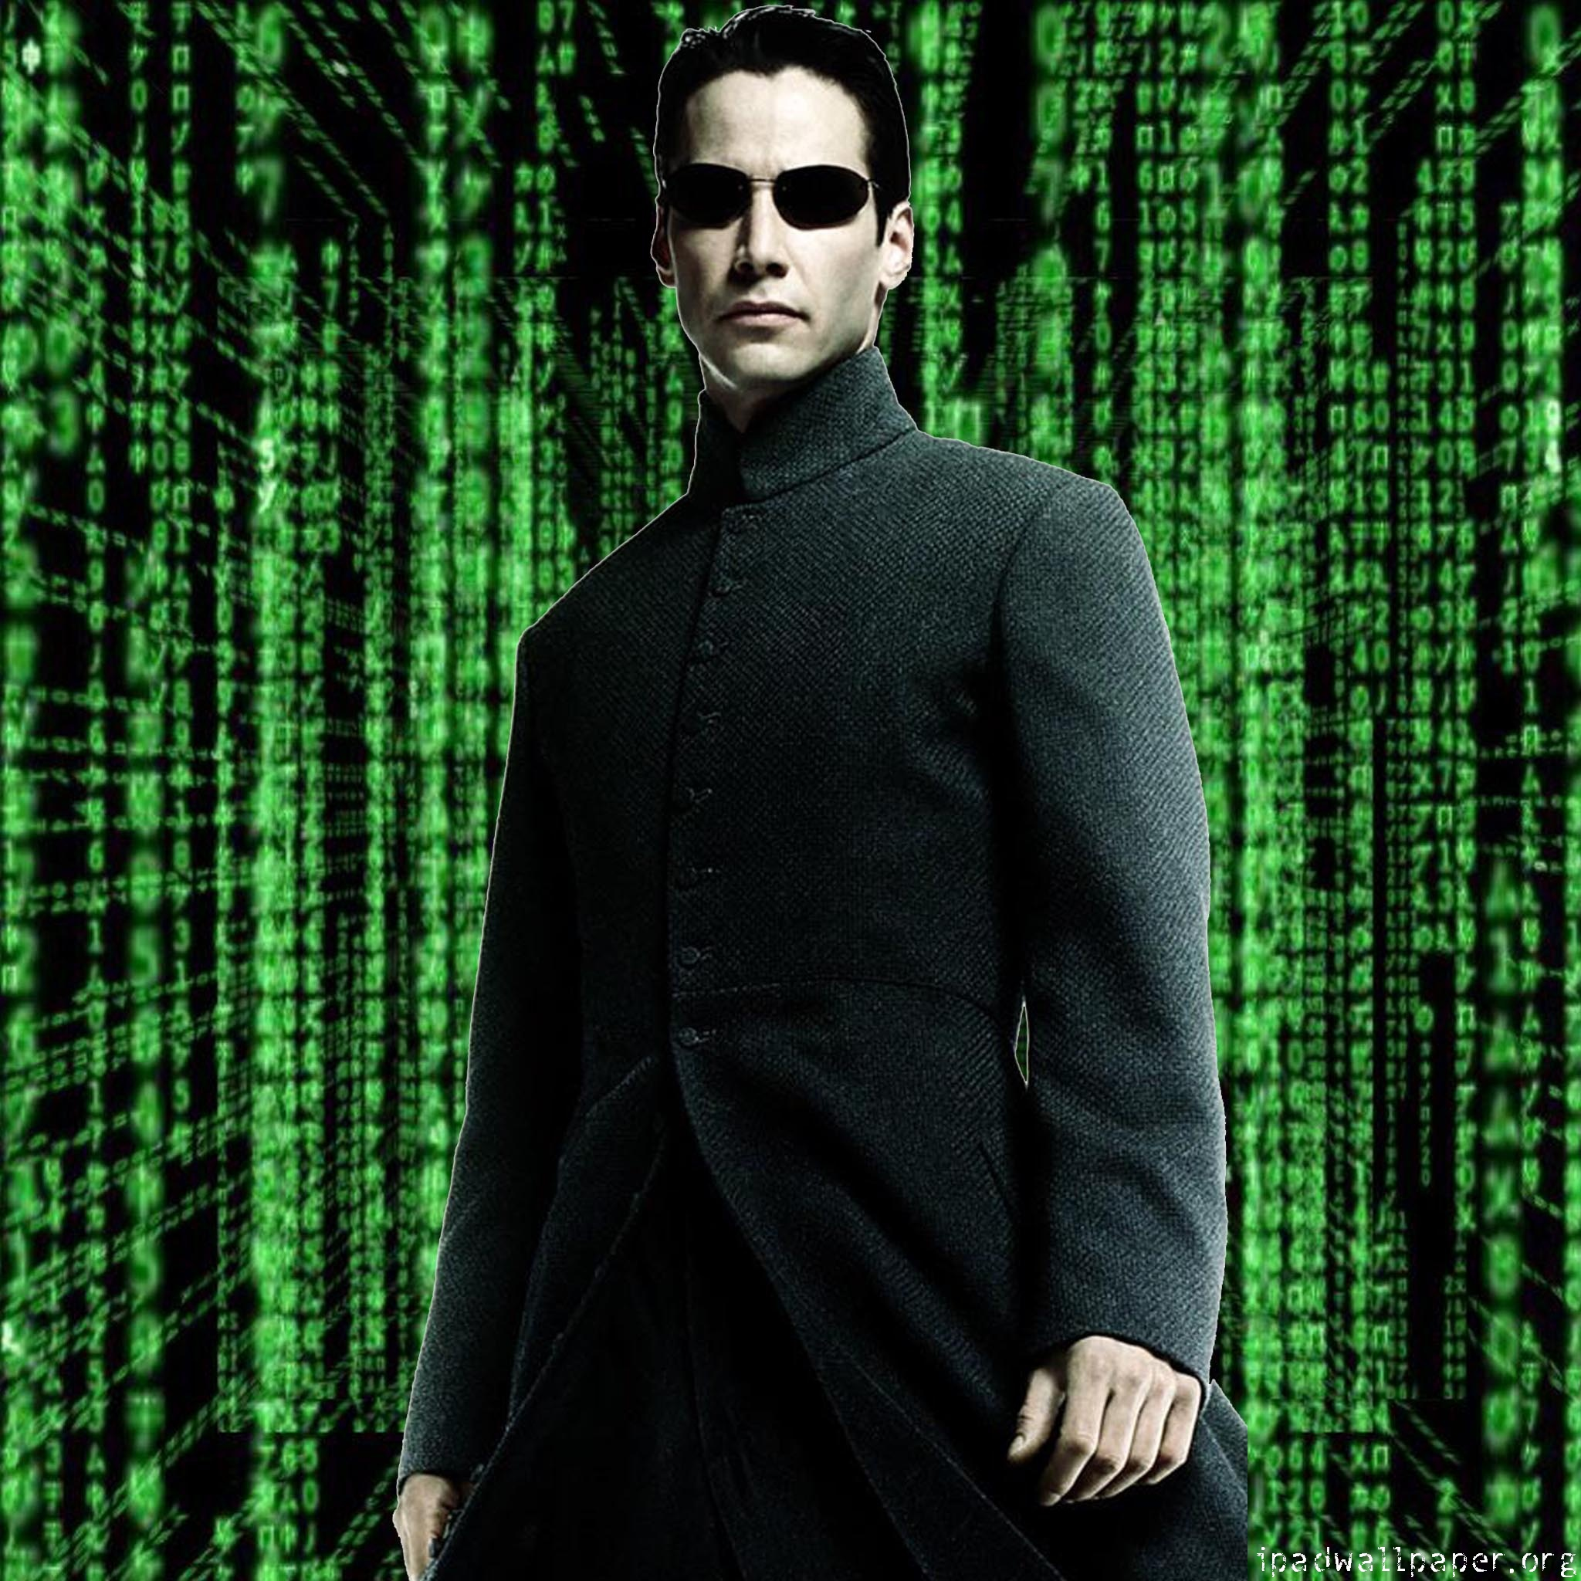

Slide 17
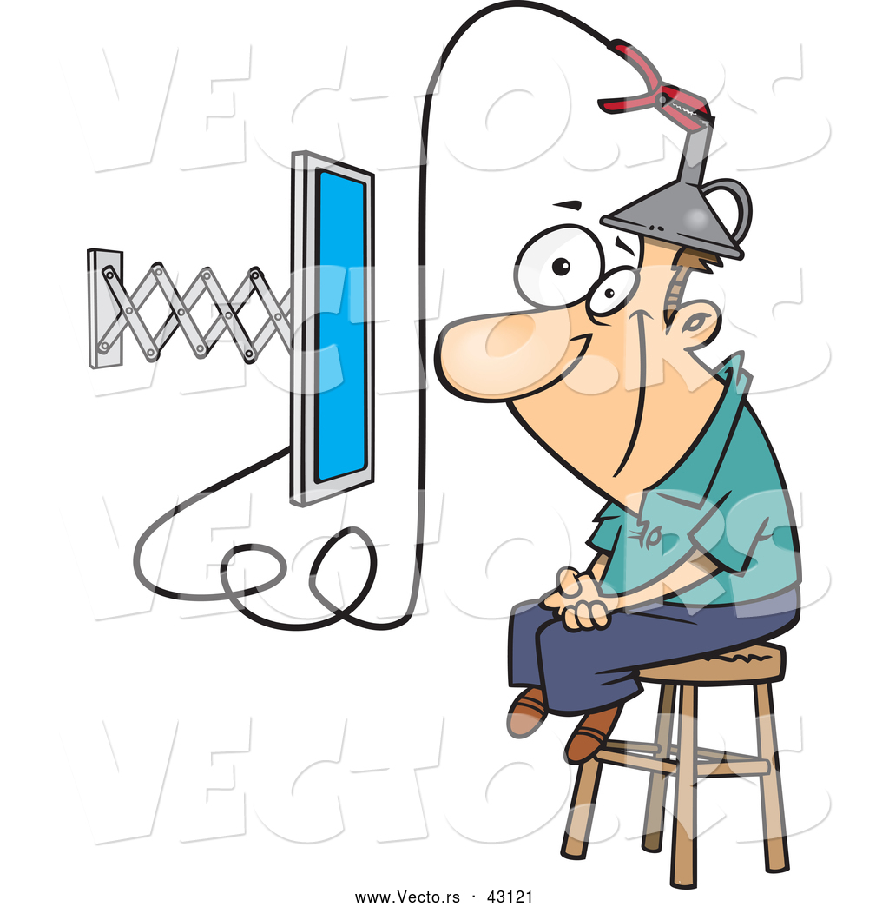

Slide 18
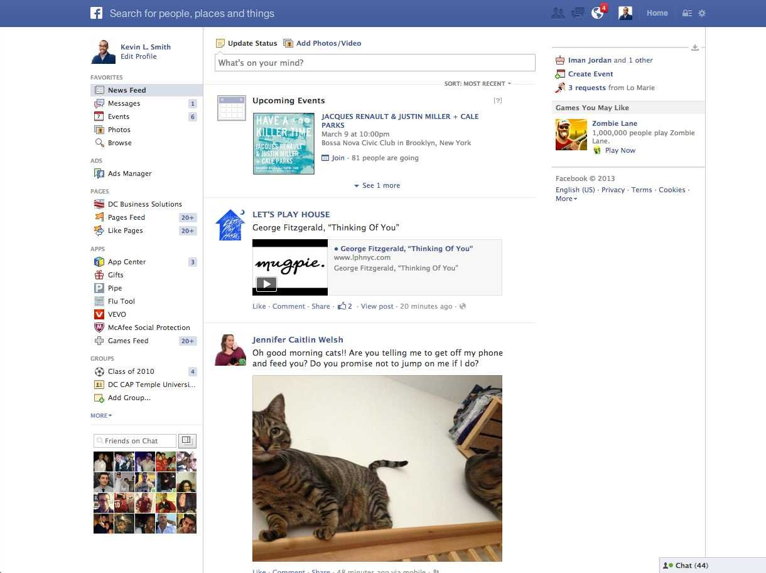

Slide 19
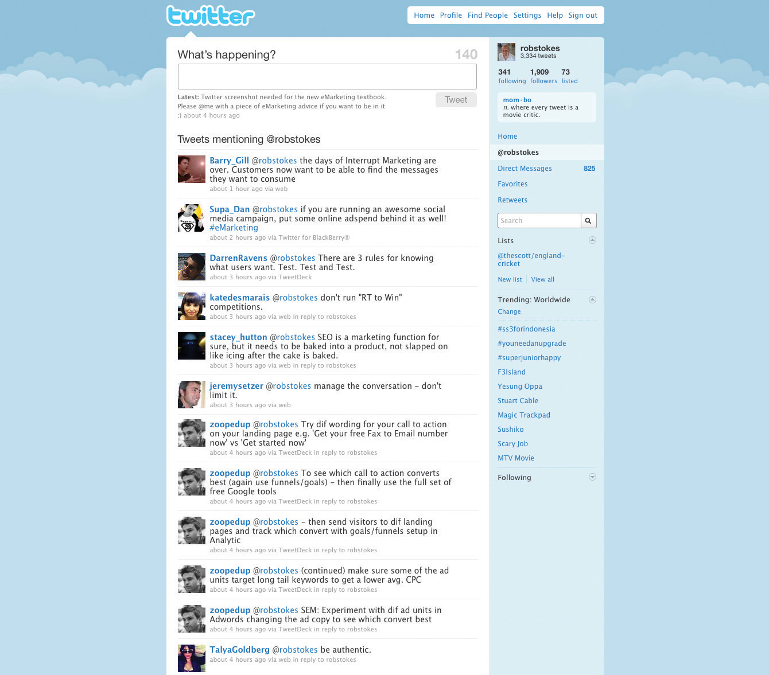

Slide 20


Slide 21


Slide 22


Slide 23
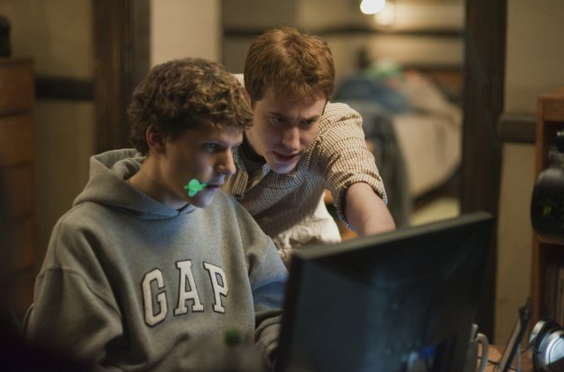

Slide 24
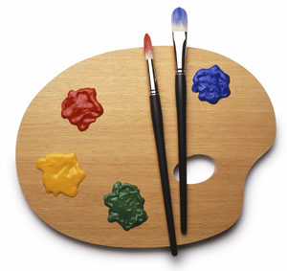
Expressing Yourself

Slide 25
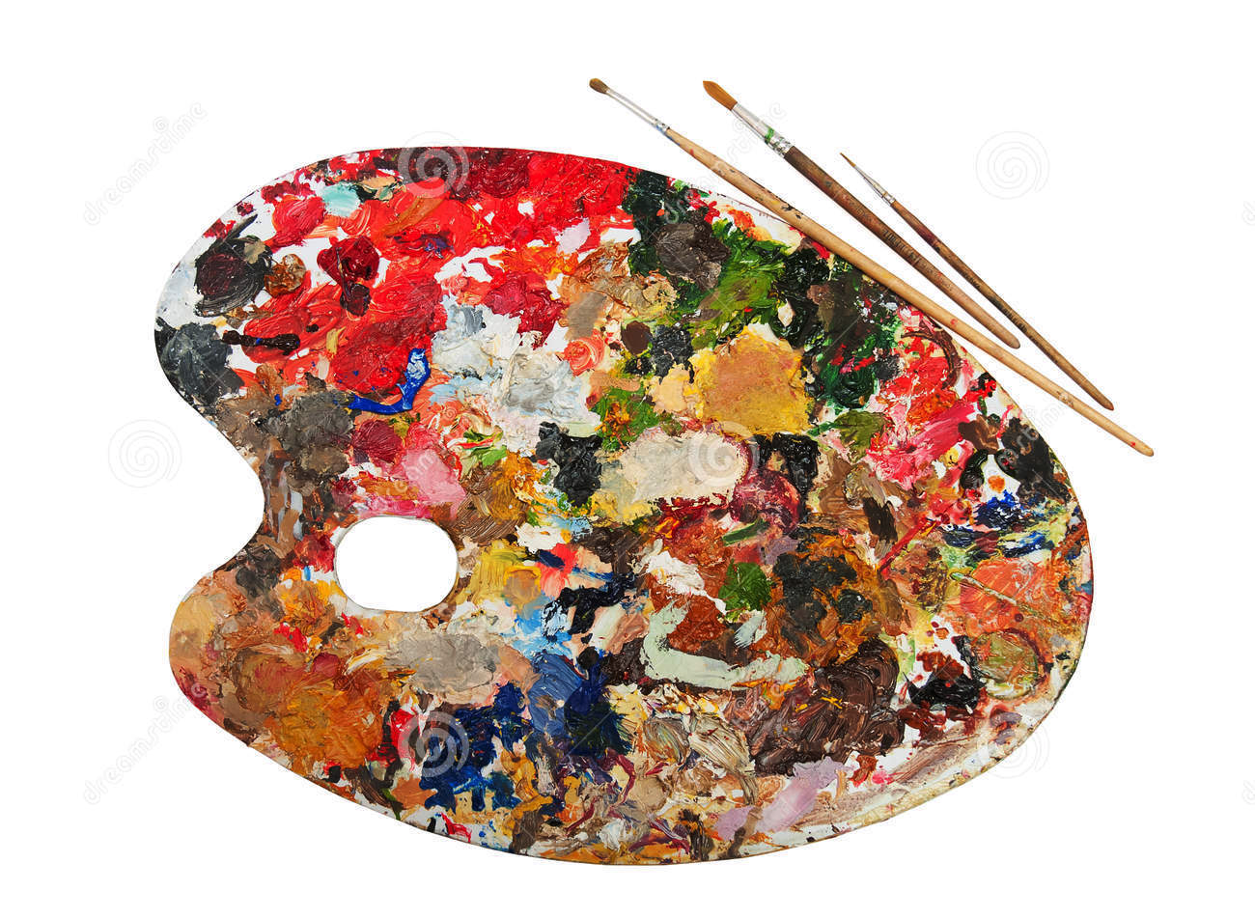
Expressing Yourself

Slide 26
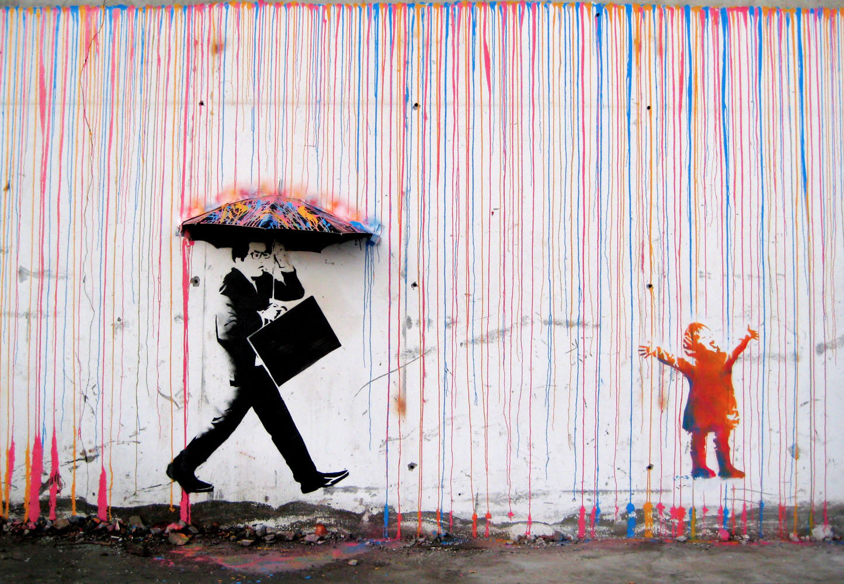

Slide 27
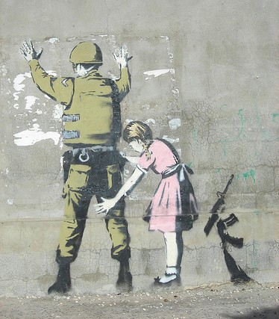

Slide 28
Don’t Ask For Permission

Slide 29
Don’t Ask For Permission Beg For Forgiveness

Slide 30
Roll With It!
If You Have A Different Idea For Something

Slide 31
We Will Challenge You To NOT Do Exactly What We Tell You To!

Slide 32


Slide 34
We Will Challenge You To Not Do Exactly What We Tell You To!

Slide 35
If You Try To Do Anything Interesting

Slide 36

You Will Fail

Slide 37
You Will Fail
A LOT

Slide 38
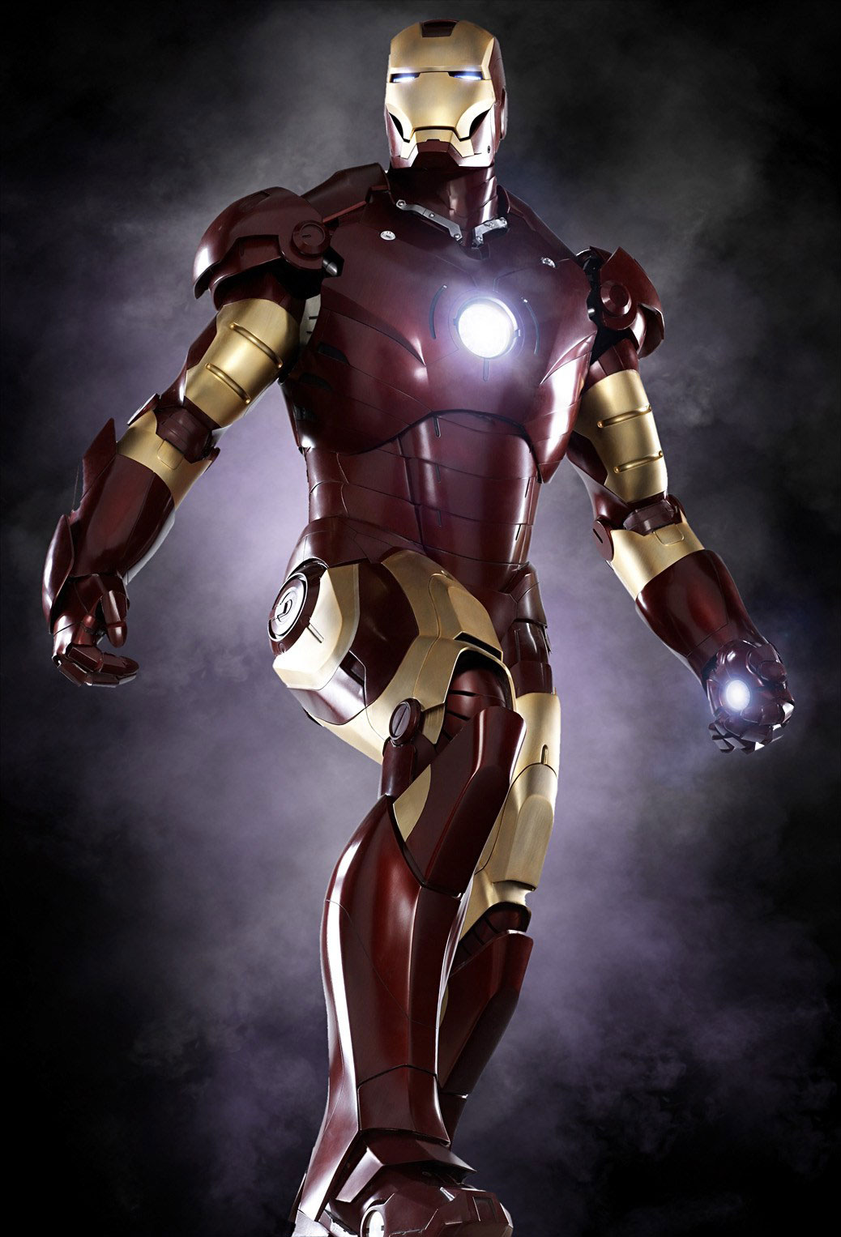

Slide 39


Slide 40
Case And Point: High School Robotics Team

Slide 41


Slide 42


Slide 43
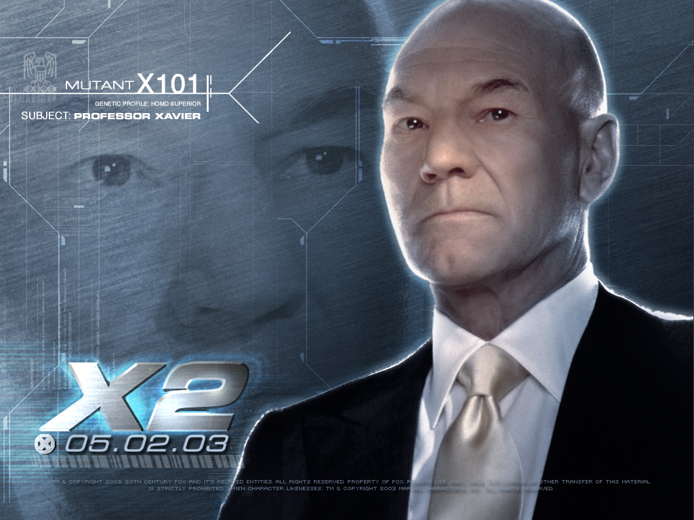

Slide 46
But You’re Supposed To

Slide 47
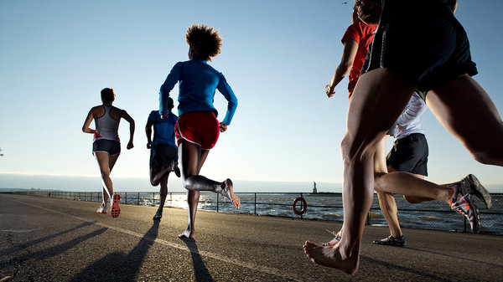

Slide 48
What’s The Best Exercise?

Slide 49
Should everyone be exercising at the same place?

Slide 50
Why are some people faster than others?

Slide 51
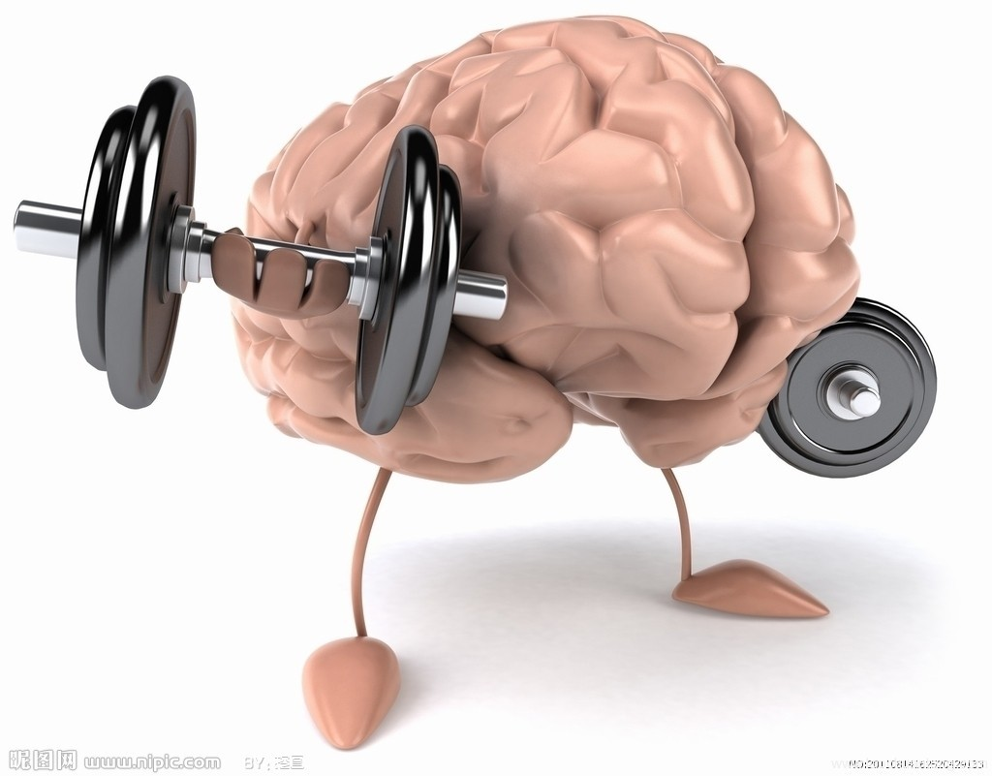

Slide 52

Grit

Slide 53
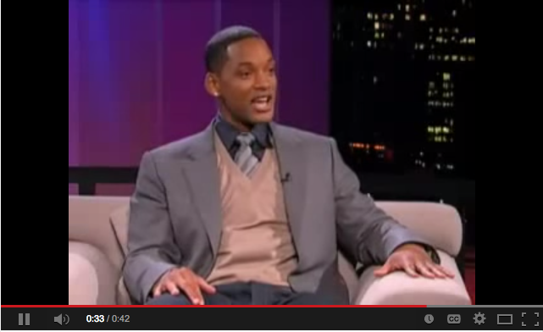

Slide 54


Experiment!

Slide 55
If you’re not failing enough, you’re not working at your peak!

Slide 56

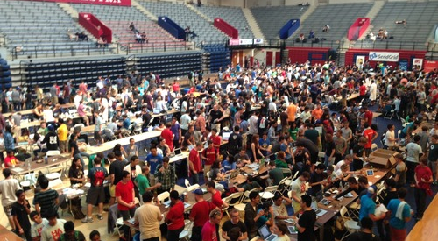

Slide 57


Slide 59
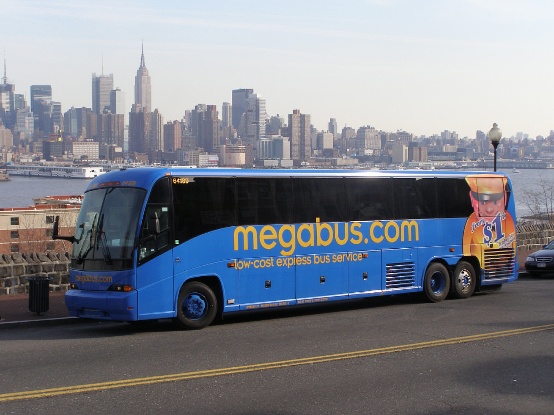

Slide 60


Slide 61
Set Status Quo

Slide 62
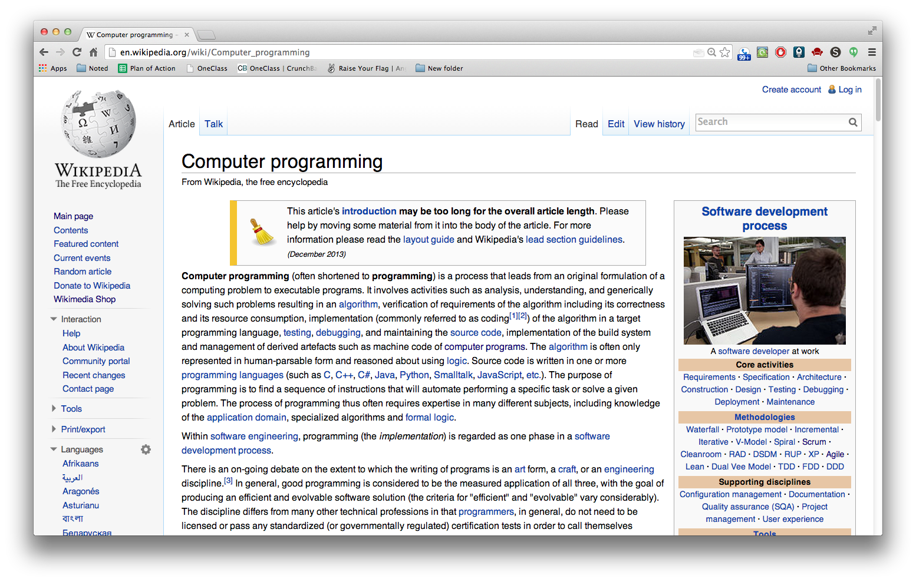

Slide 65
We Will Challenge You To Not Do Exactly What We Tell You To!

Slide 66
Challenge Accepted?

Slide 68
Is it bad to be confused and things are not working? What does that mean?

Slide 69
It’s A GOOD Thing!

Slide 71
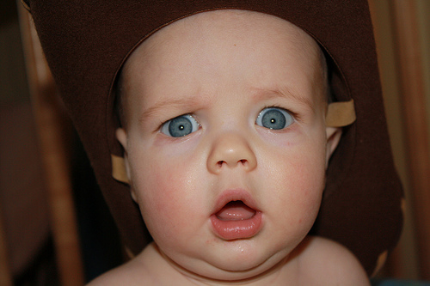
What if something, even after you tried many different ways to fix it and it still doesn’t work?

Slide 72


Slide 73
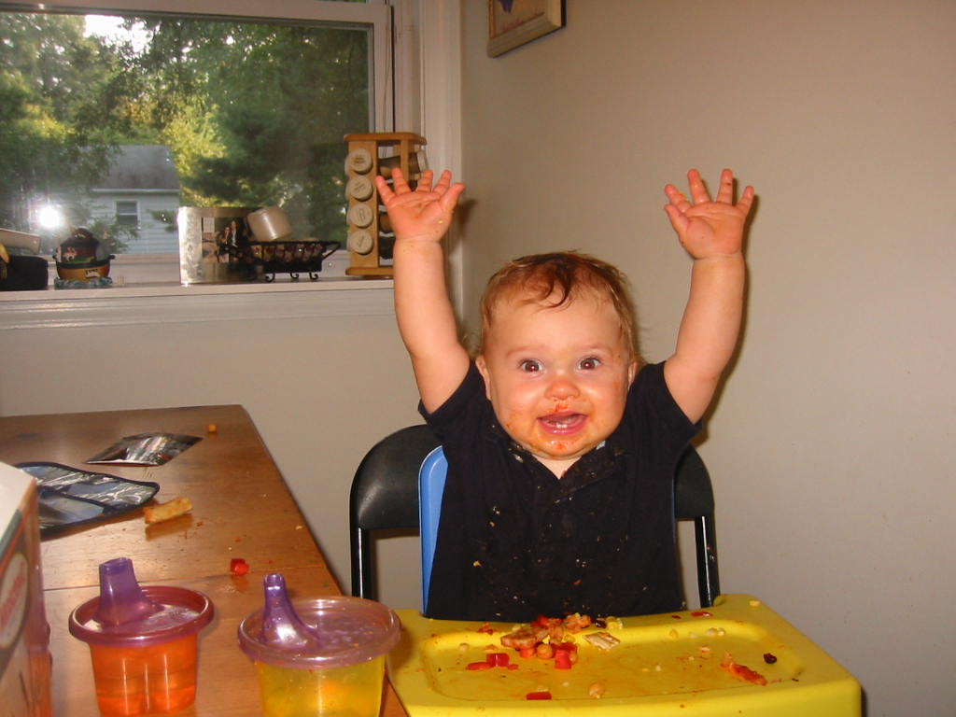

Slide 74
Ask For Help!

Slide 75
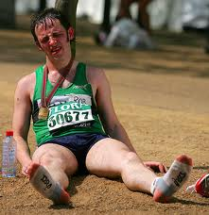
It’s Going To Get Uncomfortable

Slide 76
Zip, Zap, Zop 2.0

Slide 77
You Trailblaze The Crowd

Slide 78
Experiment!

Slide 80
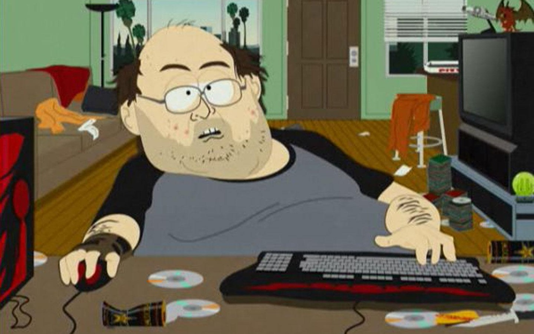

Slide 81


Slide 82
magic.jonl.org

Slide 83
Turn Your Computers So That They Face Out! The Screen Should Turn Black
magic.jonl.org

Slide 84
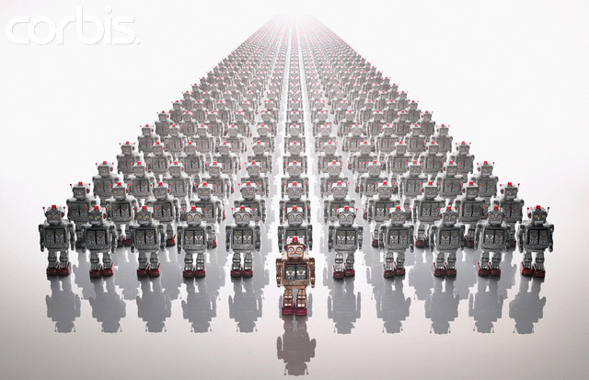

Slide 85
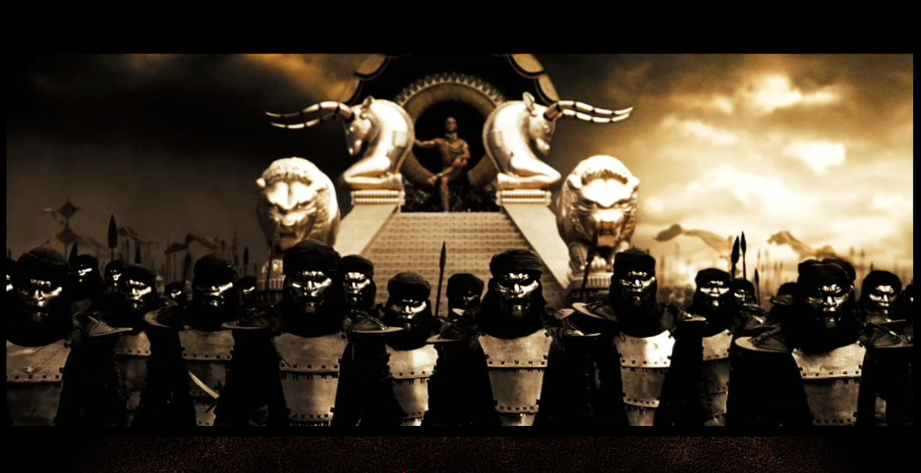

Slide 86
49.4 Million People

Slide 87
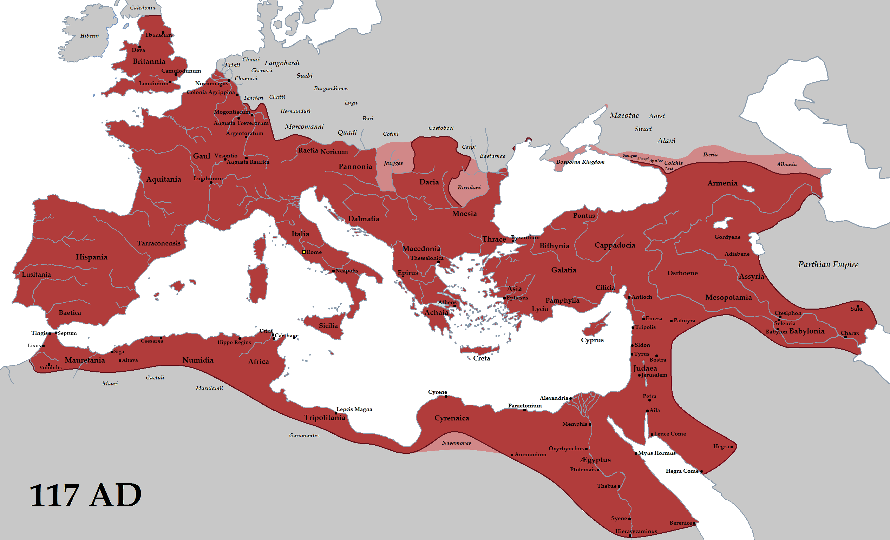

Slide 88
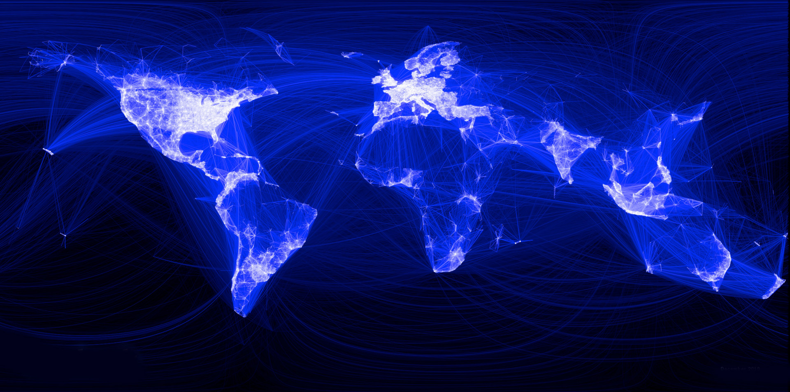
57 Million People

Slide 89
2.4 BILLION People

Slide 90
1 Video

Slide 91
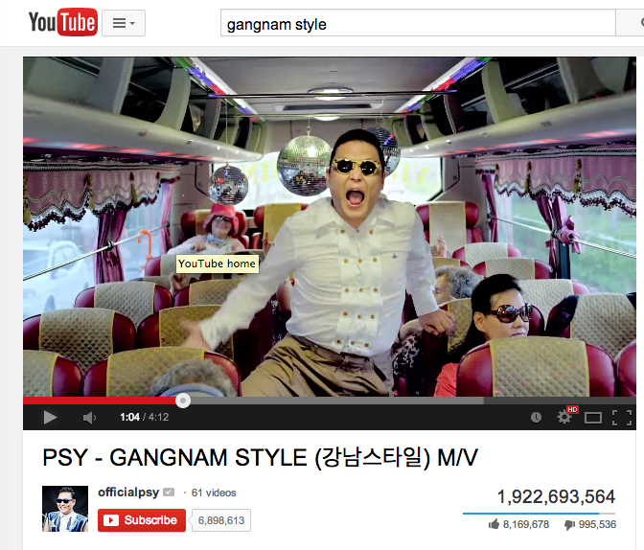

Slide 92
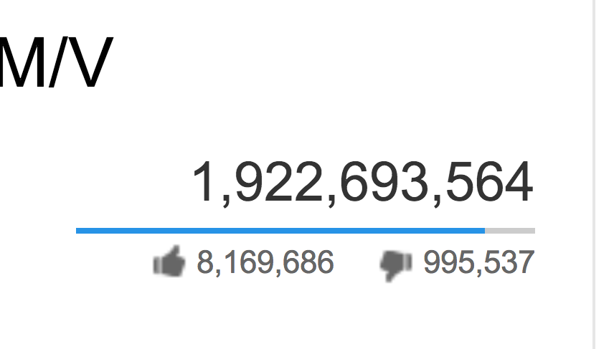

Slide 93


Slide 94
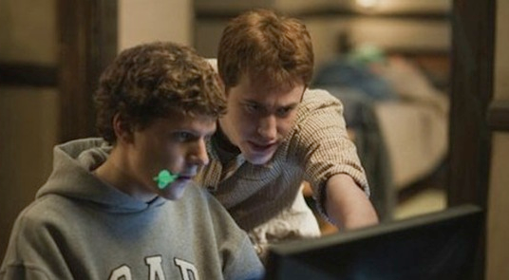
Facebook was built in a dorm room….

Slide 95
You Can Do It Too!

Slide 97
